Slide 1






Prompt Tuning
and
Instruction Fine Tuning

Slide 2





Our Team
Lahiruni Ariyawansha
Poornima Liyanage
Durangi Abeykoon
Theekshana Ranasinghe

Slide 3
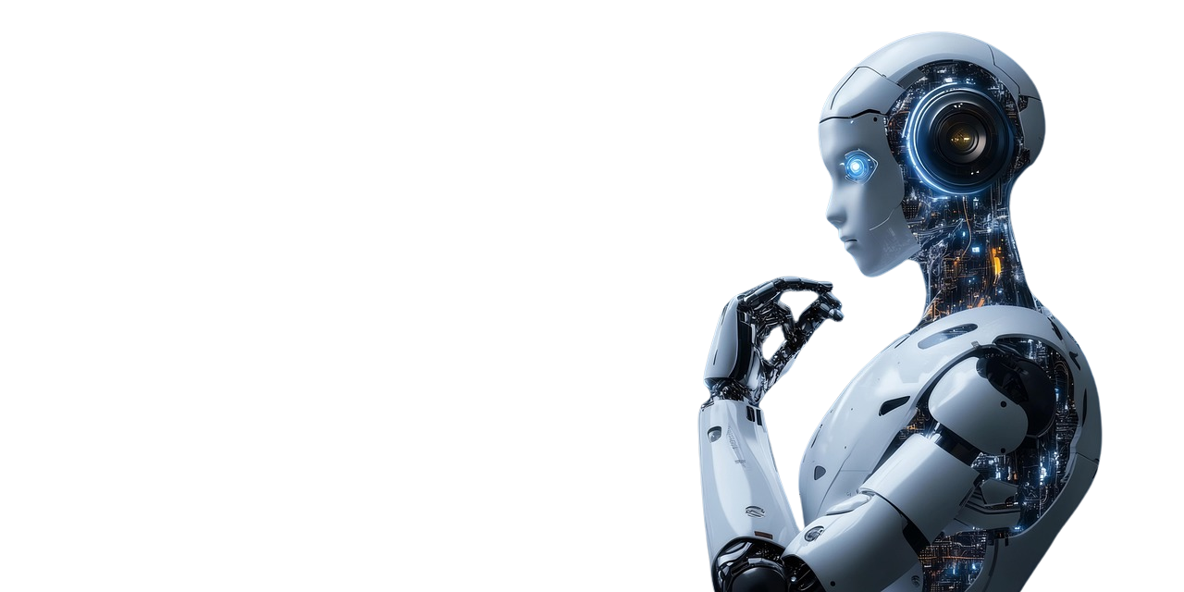
Why did we choose this topic?

Slide 4

Why this Topic?
1
Core to modern AI assistants (ChatGPT, Bard, Copilot).
2
Important research area in NLP & industry.
3
Helps us understand how to adapt AI to tasks.
4
Relevant to both research and real-world applications

Slide 5
Inroduction

Slide 6

What is a pretrained model?

Slide 7
Pretrained Model
A pretrained model is a neural network (e.g., LLM like GPT or BERT) trained on massive general datasets to learn broad patterns, language structures, and knowledge before task-specific use.

Slide 8
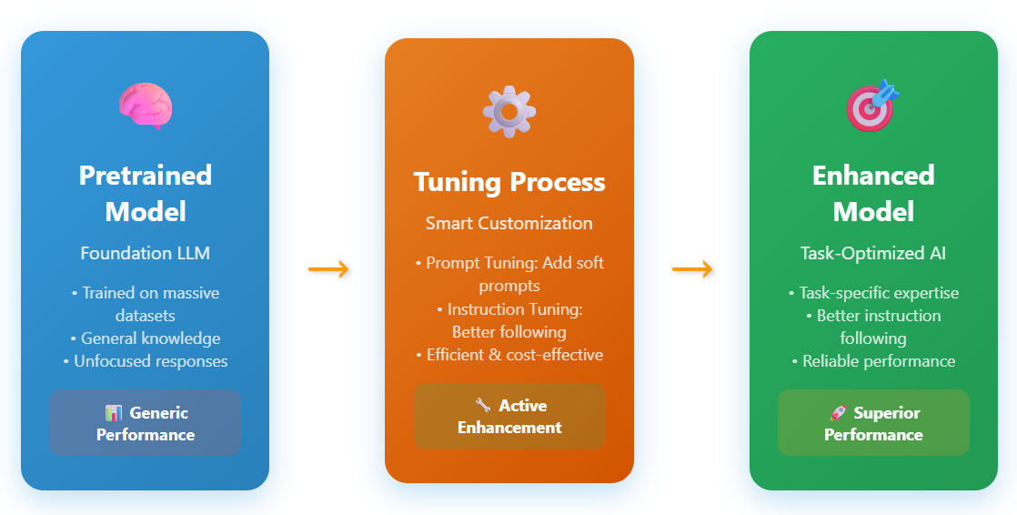

Slide 9
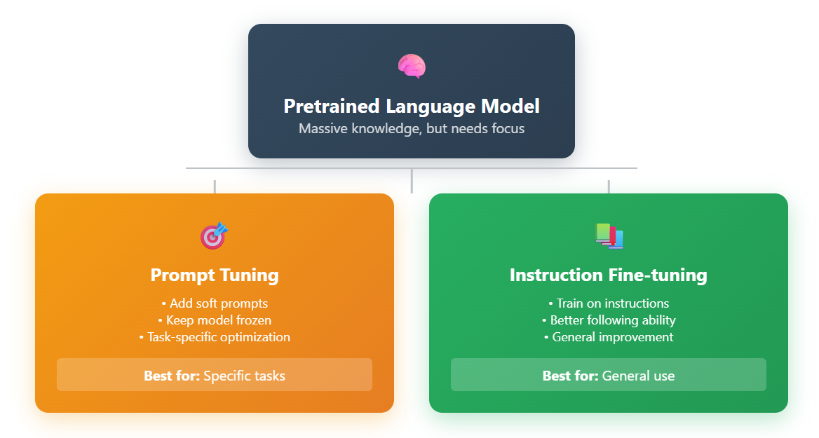
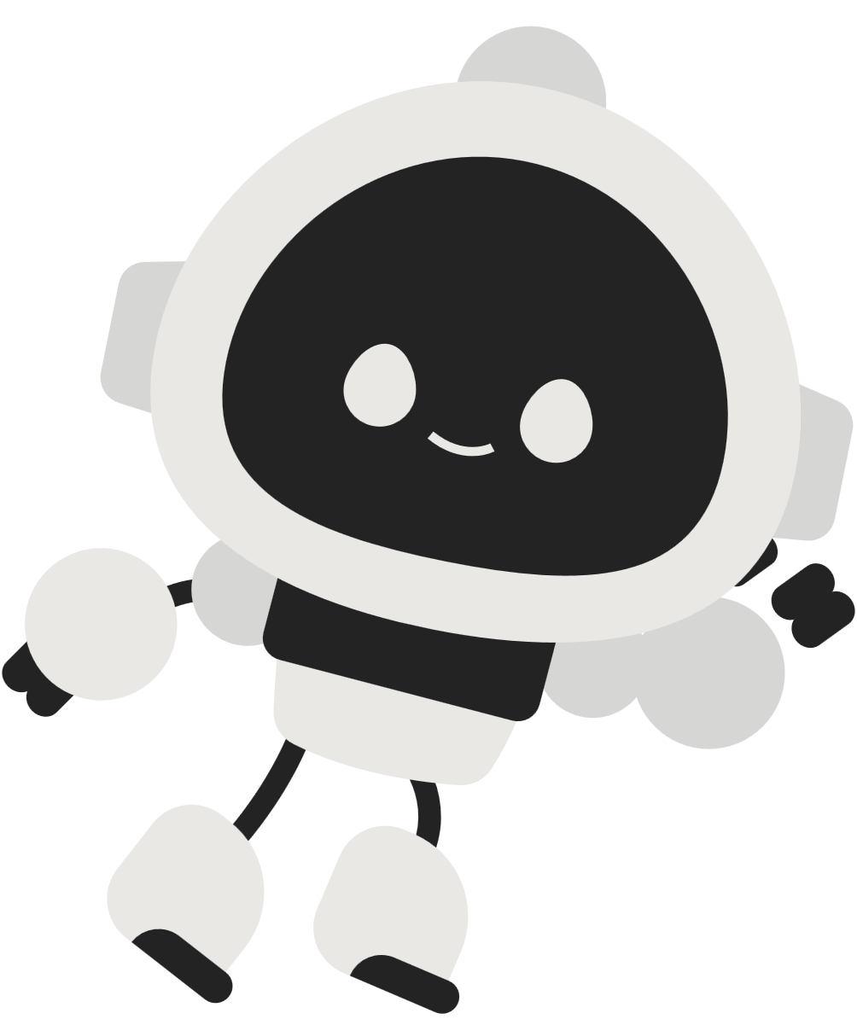


Slide 10
Base LLM
(All parameters)
Full-fine Tuning
Task Model
(All params update)
Base LLM
(Frozen)
Task Model
( + Small Prompt )
Prompt Tuning
Base LLM
Instruction Fine Tuning
Instruction Finetuned
LLM

Slide 11
Why do we need these techniques?
LLMs are extremely large
Too expensive without it
LLM responses can be generic
Adaptation problems

Slide 12
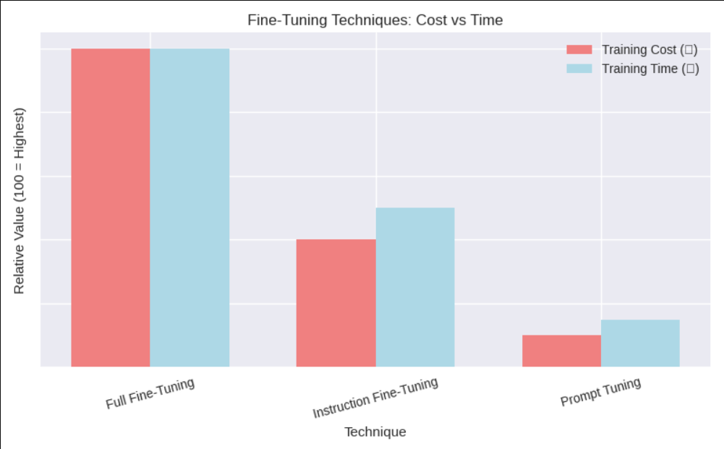

Slide 13


WITHOUT TUNING
WITH TUNING
Summarize WW1 in
2 sentences.
Summarize WW1 in
2 sentences.
🤖
🤖
“The causes of World War I are numerous and complex, involving a vast network of political alliances, military buildups, imperial rivalries, and nationalist tensions across Europe. In 1914, the assassination of Archduke Franz Ferdinand of Austria-Hungary set off a chain of diplomatic failures and escalations that resulted in the outbreak of a devastating global conflict.”
“World War I was caused by military alliances, nationalism, imperial competition, and an arms race in Europe.
The assassination of Archduke Franz Ferdinand triggered these tensions into open conflict.”

Slide 14

Prompt Tuning

Slide 15
Prompt Tuning:
Involves modifying the input to a pre-trained language model rather than altering the model's parameters.

Slide 16
Example : Prompt Tuning
BEFORE PROMPT TUNING
AFTER PROMPT TUNING
Teaching a Student
Teaching a Student
🤖
🤖
Learn everything from scratch
Learn specific question give them smart hints and reminders to solve a particular type of question.

Slide 17
When to use
Prompt Tuning?
Optimize performance on specific tasks/queries.
When full fine-tuning is too costly or unnecessary.
Faster adaptation with less data.
Improve accuracy of output generation efficiently.

Slide 18


How Prompt Tuning works?
01
02
03
04
Freeze the Core:
The main model stays completely unchanged (like keeping the engine of a car untouched)
Add Soft Prompts:
Insert these special numerical sequences before your input
Smart Training:
Show many examples of what good responses look like for specific tasks
Learn the Pattern:
Only the soft prompts get updated - they learn the "secret sauce" for better responses

Slide 19

EFFICIENCY
Advantages of Prompt Tuning
SCALABILITY
TASK GENERALIZATION
REDUCED OVERFITTING
FLEXIBILITY

Slide 20
Limitations of Prompt Tuning
TASK GENERALIZATION IS LIMITED
MAY STILL NEED DOMAIN-SPECIFIC DATA
SOMETIMES LESS ACCURATE THAN FULL FINE-TUNING

Slide 21
HEALTHCARE
Real-World Applications
CUSTOMER SUPPORT
FINANCE
EDUCATION
E-COMMERCE
LEGAL

Slide 22
Instruction Fine-Tuning

Slide 23
Instruction Fine-Tuning
Extends the base LLM’s ability to follow natural language instructions.
Uses a large dataset of instruction–response pairs.
Requires more compute, data, and cost.
This updates the model weights.

Slide 24
Process of Instruction Fine-Tuning
01
02
03
04
05
Prepare Data:
Collect many
(Instruction-Response) examples
Create Instruction–Response Pair:
Convert into structured format
Train the Model::
model weights are updated (not frozen)
Model Learns:
follow unseen instructions
0
Deploy Assistant:
Test on new instructions

Slide 25

Example Flow of Instruction Fine-Tuning
📝
💻
🤖
Instruction
Input Code
Fine-Tuned Model
Text
( snippet with error):
print("Hello World
"Fix the bug in this Python code"
Corrected Code:
print("Hello World")

Slide 26
Examples
Instruction
Input / Task
Output
📝
💻
🤖
Math Problem | Solve step by step | What is (45 × 12) ÷ 9 ? | 45 × 12 = 540 540 ÷ 9 = 60 Final Answer: 60
Translate | Translate into French | “Good morning, how are you?” | “Bonjour, comment ça va ?”
Explaination | Explain Concept | “Explain Newton’s 2nd law for a 10-year-old.” | “When you push something harder, it moves faster. Bigger things need more push.”
Summarization | Sumamrize this text | “The Amazon rainforest covers 5.5 million sq km and produces 20% of the world’s oxygen.” | "The Amazon rainforest is vital for oxygen and biodiversity.”

Slide 27
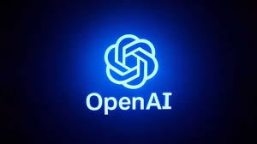

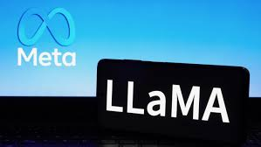

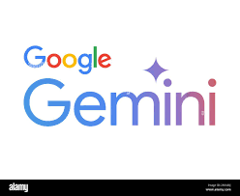

Real World Applications

Slide 28
Comparison
What Changes | Soft Prompts Only | Model weights
Data Needed | Small(~100s) | Large(~1000s+)
Cost | Cheap | Expensive
Scope | Narrow,Task Specific | Broad,General
Suitable for | Small Tasks | Wide range of tasks
FEATURE
PROMPT TUNING
INSTRUCTION FINE-TUNING

Slide 29


Pros:
Highly Efficient & Fast
Lightweight and easy deployment
Low cost operation
Pros and Cons Prompt Tuning
Cons:
Limited task flexibility
Underperforms on complex tasks
Narrow generalization capability

Slide 30
Pros:
Pros and Cons Instruction Fine-Tuning
High-quality consistent responses
Generalizes across tasks
Reliable output generation
Handles complex instructions
Cons:
Resource-intensive training
Time-consuming process
Requires large datasets
Slower iteration cycles

Slide 31



Real-World Applications
PROMPT TUNING
Specialized Chatbots: Medical Q&A, enterprise customer support.
Controlled Content Generation: Ad copy, social media in brand voice.
Rapid Prototyping for new product features.
INSTRUCTION FINE-TUNING
General AI Assistants: ChatGPT, Claude, etc.
Code Generation Models: GitHub Copilot, CodeLLama.
Creative & Complex Tasks: Story writing, complex reasoning.

Slide 32

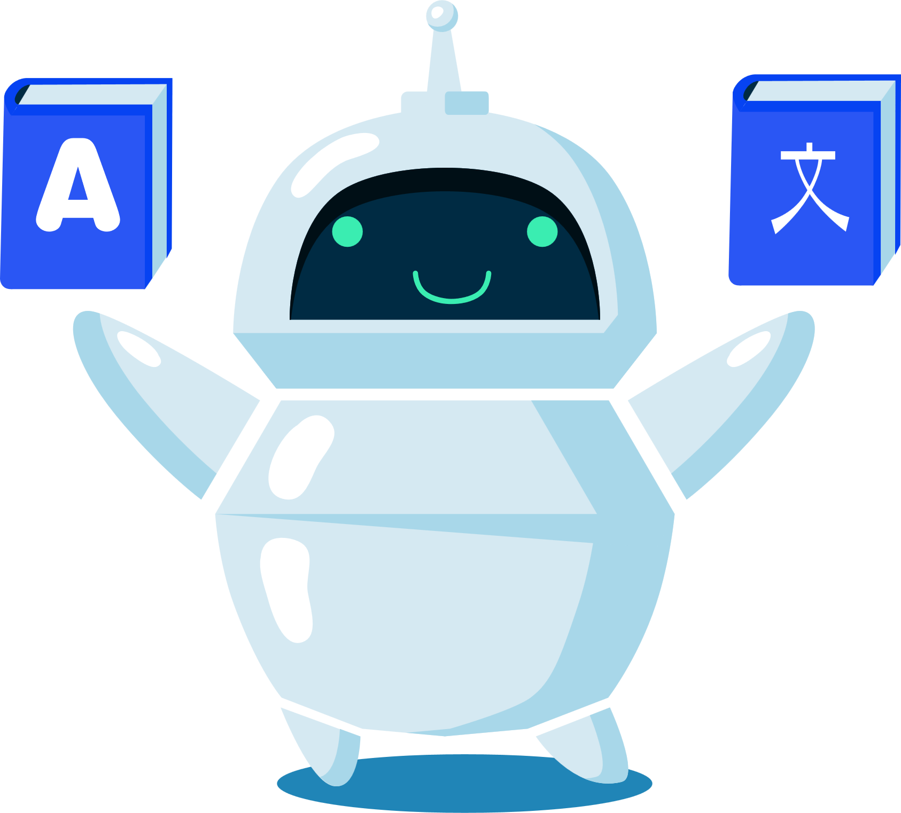
Conclusion:
Prompt tuning and instruction fine-tuning enhance large language models (LLMs) by enabling task-specific adaptation and reliable instruction-following, making AI more accurate, flexible, and aligned with human intent.

Slide 33
Thank You!

Slide 34
Any Questions?

